Slide 1
IT694 Computer Networks
Fundamentals-I

Slide 2


Host: sends packets of data
host sending function:
takes application message
breaks into smaller chunks, known as packets, of length L bits
transmits packet into access network at transmission rate R
link transmission rate, aka link capacity, aka link bandwidth
two packets,
L bits each
2
1
host
R: link transmission rate
packet
transmission
delay
time needed to
transmit L-bit
packet into link
L (bits)
R (bits/sec)
=
=

Slide 3




Packet-switching: store-and-forward
L bits
per packet
source
3
2
1
destination
R bps
R bps
packet transmission delay: takes L/R seconds to transmit (push out) L-bit packet into link at R bps
store and forward: entire packet must arrive at router before it can be transmitted on next link
One-hop numerical example:
L = 10 Kbits
R = 100 Mbps
one-hop transmission delay = 0.1 msec

Slide 4
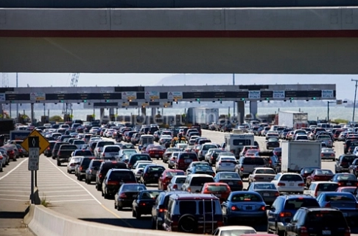
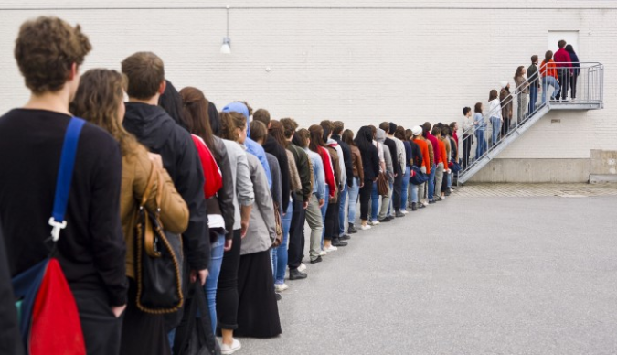
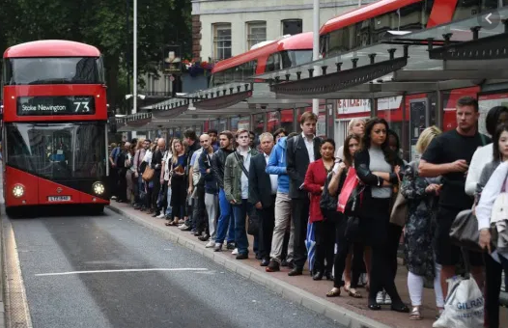
Packet-switching: queueing
R = 100 Mb/s
C
A
R = 1.5 Mb/s
D
B
E
queue of packets
waiting for transmission over output link
Queueing occurs when work arrives faster than it can be serviced:

Slide 5
Packet-switching: queueing
R = 100 Mb/s
C
A
R = 1.5 Mb/s
D
B
E
queue of packets
waiting for transmission over output link
Packet queuing and loss: if arrival rate (in bps) to link exceeds transmission rate (bps) of link for some period of time:
packets will queue, waiting to be transmitted on output link
packets can be dropped (lost) if memory (buffer) in router fills up

Slide 6
Alternative to packet switching: circuit switching
end-end resources allocated to, reserved for “call” between source and destination
in diagram, each link has four circuits.
call gets 2nd circuit in top link and 1st circuit in right link.
dedicated resources: no sharing
circuit-like (guaranteed) performance
circuit segment idle if not used by call (no sharing)
commonly used in traditional telephone networks
* Check out the online interactive exercises for more examples: http://gaia.cs.umass.edu/kurose_ross/interactive

Slide 7
Circuit switching: FDM and TDM
Frequency Division Multiplexing (FDM)
optical, electromagnetic frequencies divided into (narrow) frequency bands
4 users
frequency
each call allocated its own band, can transmit at max rate of that narrow band
time
Time Division Multiplexing (TDM)
time divided into slots
frequency
each call allocated periodic slot(s), can transmit at maximum rate of (wider) frequency band (only) during its time slot(s)
time

Slide 8
Packet switching versus circuit switching
example:
1 Gb/s link
each user:
100 Mb/s when “active”
active 10% of time
…..
N
users
1 Gbps link
Q: how many users can use this network under circuit-switching and packet switching?
circuit-switching: 10 users
packet switching: with 35 users, probability > 10 active at same time is less than .0004 *
Q: how did we get value 0.0004?
A: HW problem (for those with course in probability only)
* Check out the online interactive exercises for more examples: http://gaia.cs.umass.edu/kurose_ross/interactive

Slide 9
Packet switching versus circuit switching
Is packet switching a “slam dunk winner”?
great for “bursty” data – sometimes has data to send, but at other times not
resource sharing
simpler, no call setup
excessive congestion possible: packet delay and loss due to buffer overflow
protocols needed for reliable data transfer, congestion control
Q: How to provide circuit-like behavior with packet-switching?
“It’s complicated.” We’ll study various techniques that try to make packet switching as “circuit-like” as possible.
Q: human analogies of reserved resources (circuit switching) versus on-demand allocation (packet switching)?

